Slide 1
Lecture #7: Coding algorithms

Slide 2
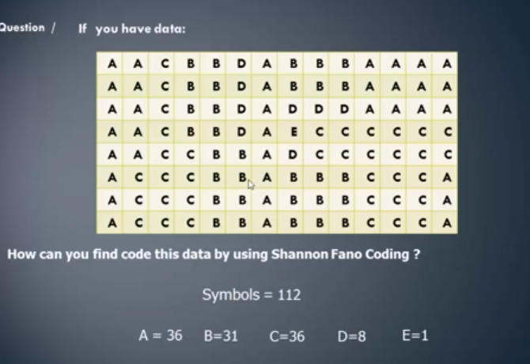

Slide 3
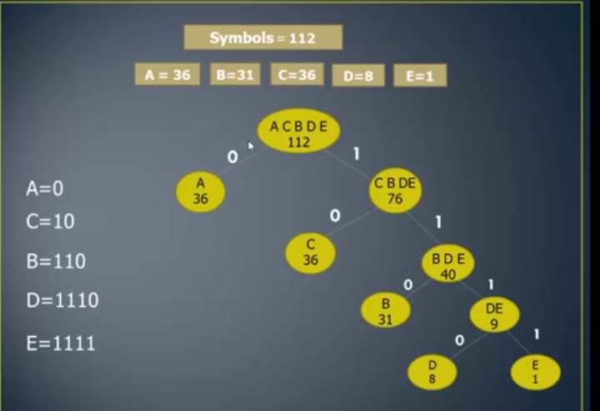

Slide 4

Shannon-Fano-Elias Coding
Cumulative distribution function (CDF)
$$F\left(x\right)=\sum_{a≤x}{p(a)}$$
Example
$X=\left\{x1,x2, x3, x4, x5\right\}$
$P(X)= \{0.25, 0.25, 0.2, 0.15, 0.15\}$
$F(X) = \{0.25, 0.5, 0.7, 0.85, 1\}$

Slide 5
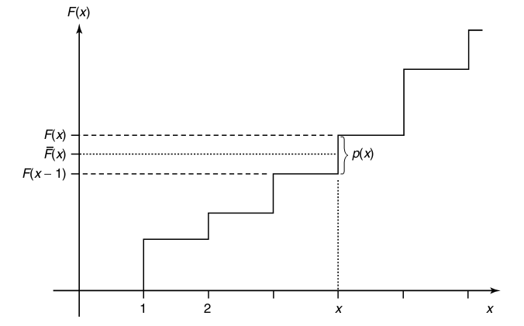
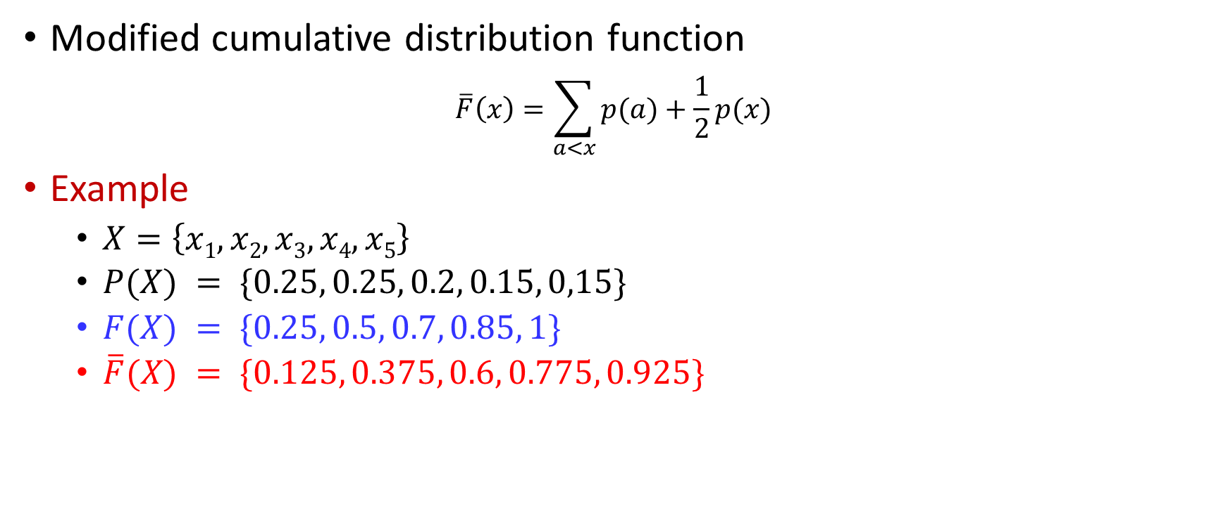
Shannon-Fano-Elias Coding
Modified cumulative distribution function
$$\overline{F}\left(x\right)=\sum_{a<x}{p(a)}+\frac{1}{2}p(x)$$
Example
$X=\left\{x1, x2, x3, x4, x5\right\}$
$P(X) = \{0.25, 0.25, 0.2, 0.15, 0,15\}$
$F(X) = \{0.25, 0.5, 0.7, 0.85, 1\}$
$\overline{F}(X) = \{0.125, 0.375, 0.6, 0.775, 0.925\}$

Slide 6
Shannon-Fano-Elias Coding: An Example
Consider a random variable X taking values in the set X ={1, 2, 3, 4, 5} with probabilities 0.25, 0.25, 0.2, 0.15, 0.15, respectively.
Using Shannon-Fano-Elias Coding method

Slide 7
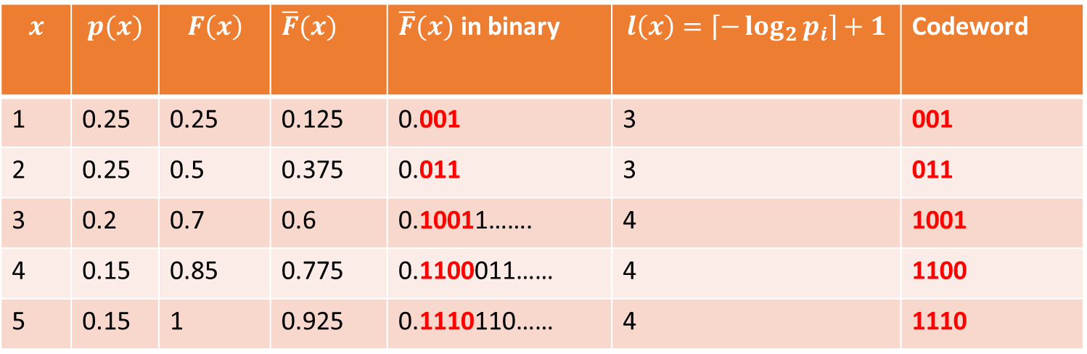
Shannon-Fano-Elias Coding: An Example
$$x$$ | $$p(x)$$ | $$F\left(x\right)$$ | $\overline{F}(x)$ | $\overline{F}(x)$ in binary | $$l\left(x\right)=\left\lceil −\log_{2}{p_{i}}\right\rceil +1$$ | Codeword
1 | 0.25 | 0.25 | 0.125 | 0.001 | 3 | 001
2 | 0.25 | 0.5 | 0.375 | 0.011 | 3 | 011
3 | 0.2 | 0.7 | 0.6 | 0.10011……. | 4 | 1001
4 | 0.15 | 0.85 | 0.775 | 0.1100011…… | 4 | 1100
5 | 0.15 | 1 | 0.925 | 0.1110110…… | 4 | 1110

Slide 8
Generic Communication System
Transmitter
Noisy Channel
Receiver

Slide 9





Generic Communication System
$$Noise$$
Source
$$W$$
Encoder
$$X$$
Channel
P(Y|X)
$$Y$$
Decoder
$$\hat{W}$$
Destination
Source
Coder
Channel
Coder
Channel
Decoder
Source
Decoder
Remove Redundancy
Controlled Addition of Redundancy
Detect/Correct Errors
Restore Source

Slide 10
Examples of Channel Capacity
EXAMPLES OF CHANNEL CAPACITY are:
Noiseless Binary Channel
Noisy Channel with Non overlapping Outputs
Noisy Typewriter
Binary Symmetric Channel (BSC)
Z-Channel
Binary Erasure Channel

Slide 11

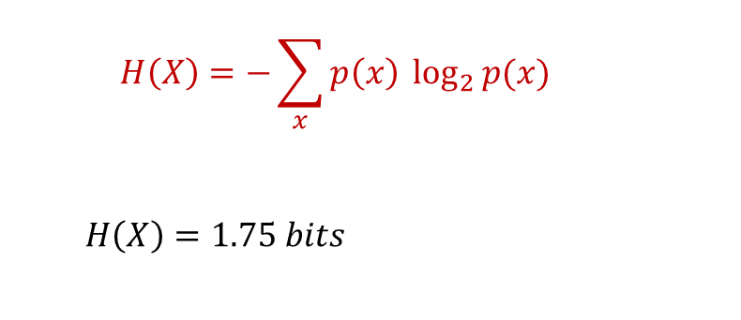
An explanation example
Random Variable (X) | Probability (p_{i} ) | Code 1 (fixed length) | Code 2 (Variable length)
1 | 1/2 | 00 | 0
2 | 1/4 | 01 | 10
3 | 1/8 | 10 | 110
4 | 1/8 | 11 | 111
Average code length → |  | 2 | 1.75
$$H\left(X\right)=−\sum_{x}{p\left(x\right) \log_{2}{p(x)}}$$
$$H\left(X\right)=1.75 bits$$

Slide 12
Source coding
What is source coding?
it the process of encoding data using fewer bits than the original representation, by identifying statistical redundancy.
What is a source code?
A source code C for a random variable X is a mapping from the range of X to a set of finite-length strings of symbols from a D -ary alphabet. Let C(x)denote the codeword corresponding to x and let l(x) denote the length of C(x).
For example, C(red) = 00, C(blue ) = 11 is a source code for X ={red, blue } with alphabet D ={0, 1}.

